Slide 1
Are you well architected?

Slide 2

Hello
Notes:
Cloud architect at Burendo – digital product consultancy
Strategy and design
Delivery
Engineering
Operation and evolution
AWS partners
20+ years designing and building enterprise and consumer apps
Last 5 years in NHS and Govt
Primarily in AWS

Slide 3
Are you well architected?
Notes:
How confident are you that those systems are built following Best Practices for the Cloud?
Hopefully most of us would say yes, after all we have great people in our teams!
Some common customer problems that we help solve for:
- Detect and respond to security events
- Defining standards to manage daily operations
- Protecting your systems
- Ensure workload performance is correct and consistent
- Using IT and Computing resources efficiently
- Scaling to meet business need without over spending

Slide 4

AWS Well Architected Framework
Notes:
In this session we are talking about AWS Well-Architected, what it is, and how it can help you build secure, resilient, and cost-effective systems in the cloud.
Before we dive into that I wanted to gauge where everyone is on their cloud journey.
Hands up for
Already running workloads on AWS?
Heard of well architected framework?
Had a workload reviewed?
Done a review?

Slide 5
What?
Notes:
The Well-Architected Framework is a set of questions and design principles across six pillars.
Alongside with the Pillars of the AWS Well-Architected framework are AWS Well-Architected Lenses, which
provide guidance with a focus on specific industry or technology domains.
Questions that are key concepts with Best Practices that customers should evaluate if they have in place for each question

Slide 6
Why?
Notes:
Why would I want to apply the AWS Well-Architected Framework?
Because you want to:
Build and deploy faster: By reducing firefighting, capacity management and by using automation, you can experiment and release value more often.
Lower or mitigate risks: Understand where you have risks in your architecture, and address them before they impact your business and distract your team.
Make informed decisions: Ensure you have made active architectural decisions that highlight how they might impact your business outcomes.
Learn AWS Best Practices: Make sure your teams are aware of best practices that we have learned through reviewing thousands of customers’ architectures on AWS.
We have seen customers use the AWS Well-Architected Framework to successfully achieve all of these.

Slide 7
How?
Notes:
To drive better outcomes for customers who build and operate workloads on the cloud
Well-Architected (WA) is more than a set of best practices and console based tool.
WA is a mechanism for our customers cloud journey.
Allowing you to:
Learn the Strategies & best practices for architecting in the cloud
Measure your architecture using AWS Well-Architected Framework, AWS Well-Architected lenses and your organizations best practices using Custom Lenses within the Well-Architected Tool
Improve your cloud architectures by addressing any high risk issues identified using improvement plans, Well-Architected Labs, partners, SAs and more.
At AWS we understand the value of educating customers on architecture best practice
Ensure we are actively thinking about foundational areas that are often neglected
The WA Framework provides a consistent approach to evaluating architectures and also allows you to measure your workload against your own best practices, in addition to the Well-Architected Framework, and perform associated reviews for all technology and governance needs across their organization – becoming a central place for architecture best practices

Slide 8

Pillars
Notes:
6 pillars
Operational Excellence
Security
Reliability
Performance Efficiency
Cost Optimization
Sustainability
+ general design principles

Slide 9

Design Principles
Notes:
Design Principles help you adopt the appropriate mental model when building for the cloud, ensuring you take advantage of the capabilities of AWS and free yourself from the constraints of traditional approaches.
Stop guessing your capacity needs
Test systems at production scale
Automate to make architectural experimentation easier
Allow for evolutionary architectures
Drive architectures using data
Improve through game days
Cloud computing has opened up the technology space to a whole new world of thinking where constraints we used to have in the traditional environment no longer exist.
When thinking about general design principles, it’s interesting to contrast with how you would think about this in a traditional environment:
You had to guess how much infrastructure you needed, often based on very high-level business requirements and demand – often before a line of code is written.
You could not afford to test at scale (a complete duplicate of production costs is hard to justify, especially with low utilization), so when you went into production you normally found a whole new class of issues at high scale
Any proof of concepts or architectural experimentation was done by hand and was generally only done at the start of the project.
You generally had static architectures and it was difficult to even think about making a change.
You generally couldn’t generate data sets that would allow you to make informed decisions, so you probably used models and assumptions to size your architecture
Finally in a traditional environment, you would only exercise your runbook when something bad happened in production.
In the cloud constraints have been removed, so you can use these principles to take advantage of that.
Improve through game days: Test how your architecture and processes perform by regularly scheduling game days to simulate events in production. This will help you understand where improvements can be made and can help develop organizational experience in dealing with events.
Prepare for security events: Prepare for an incident by having incident management and investigation policy and processes that align to your organizational requirements. Run incident response simulations and use tools with automation to increase your speed for detection, investigation, and recovery.

Slide 10

Operational Excellence
Notes:
Operational Excellence: The ability to run and monitor systems to deliver business value and continually improve supporting processes and procedures.
Perform operations as code
Make frequent, small, reversible changes
Refine operations procedures frequently
Anticipate failure
Learn from all operational failures
Most changes were made by human beings following runbooks that were often out of date
It was easy to become very focused on the technology metrics rather than business outcomes
Because making change was difficult and risky, we tended not to want to do it often and therefore tended to batch changes into large releases
We rarely simulated failures or events as we were too busy fighting fires from real failures
We were so busy reacting to situations it was hard to take the time to extract learnings
It was hard to keep information current as we were making changes to everything to fight fires, every server was a snowflake.
In the cloud, constraints of a traditional environment are removed, and you can use the design principles of the Operational Excellence pillar to make all changes by code with business metrics that you can measure your success against. By automating change and using code, you can move to making incremental changes and reduce risk. You can build organizational muscle memory by running game-days that simulate failures to test your recovery processes, and learn from these and other operational events to improve your responses. Finally, because infrastructure is now code, you can detect when documentation is out of date and even generate documentation.

Slide 11

Security
Notes:
Security: The ability to protect information, systems, and assets while delivering business value through risk assessments and mitigation strategies.
Implement a strong identity foundation
Enable traceability
Apply security at all layers
Automate security best practices
Protect data in transit and at rest
Keep people away from data
Prepare for security events

Slide 12
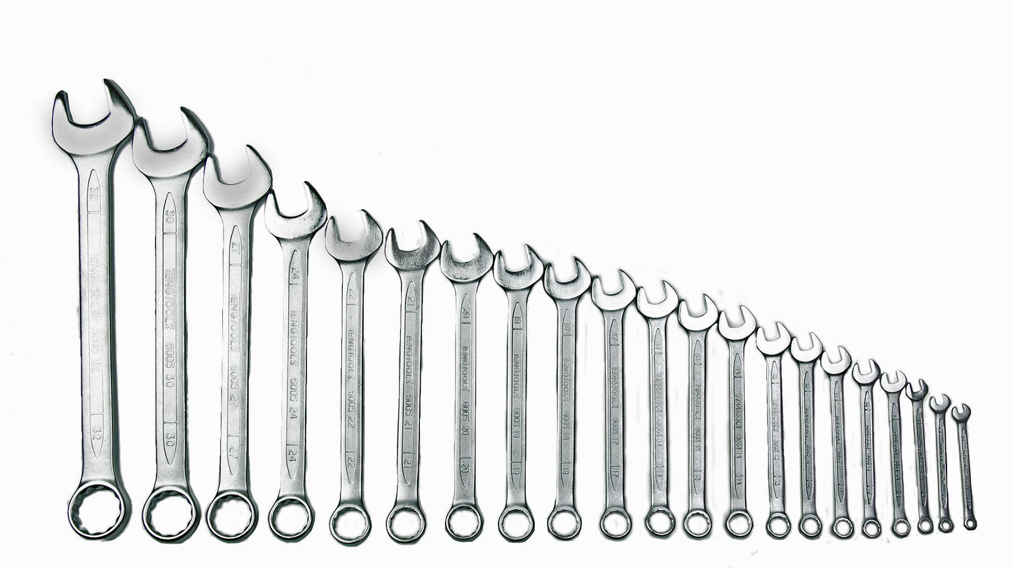
Reliability
Notes:
Reliability: The ability of a system to recover from infrastructure or service failures, dynamically acquire computing resources to meet demand, and mitigate disruptions such as misconfigurations or transient network issues.
Automatically recover from failure
Test recovery procedures
Scale horizontally to increase aggregate workload availability
Stop guessing capacity
Manage change in automation
Let’s think about how we might think about reliability in a traditional environment:
We often test if things work normally – we check if it meets expectations. But, we rarely test what happens after things fail, so the first time we test our recover process is in the middle of a live reliability failure (not a great learning experience!). This is why you used to see lots of systemic failures – X failed and then Y failed (Y being the thing we never got to test)
When a failure occurs, we manually fix it – if it happens a lot we write down the procedures for fixing – a very manual process
And, we had to guess how much we needed, so we if we got that wrong we had long provisioning times, which could lead to outages.
And we made changes to our environments manually, which introduced the opportunity for human error and snowflake servers (perfectly individual)
In the cloud constraints have been removed, that allows us to adopt these design principles to build and operate cloud native architectures -
to test beyond destruction to make sure recovery procedures are automatic and successful,
we can have multiple resources answering requests – such that a failure in any single component always has siblings who can step in and absorb the load
we can use the horizontal scaling to meet demand
and when we make changes to our environment we can do that through code – and apply the same best practices we would apply to application code.

Slide 13

Performance Efficiency
Notes:
Performance Efficiency: The ability to use computing resources efficiently to meet system requirements, and to maintain that efficiency as demand changes and technologies evolve.
Democratize advanced technologies
Go global in minutes
Use serverless architectures
Experiment more often
Consider Mechanical sympathy
As we did before, let’s think about the kinds of constraints we had in a traditional environment when thinking about PE:
We tended to use the same tech for everything, when the only tool you had is a hammer – every problem looks like a nail. Generally, this is why you saw so many RDBMS
We stayed local, as global was too hard and too expensive – even the thought of negotiating a contract with a supplier in a different country, legal framework and language was enough to stop most conversations here
We used lots of servers, that did one thing – and we had to have people to manage all those servers.
It’s hard to get the resources to do experiment, it takes a lot of time to set up, and it’s not very common
We tended to force technologies to do what we need, and then hope we could get the performance we needed
In the cloud constraints have been removed, that allows us to adopt these design principles to build and operate cloud native architectures -
skills such as machine learning and media transcoding are not evenly distributed across technologists, so having AWS setup and configure those services for you, it makes adoption easier.
deploying to global locations is a click of a button and not a legal process,
we can create solutions that are fully managed so we can focus on the code that add values
and experimentation is something we can do continuously
and we have a bigger toolbox of techniques, and select the one that works best for what we are trying to do. For example, if you have relational information then you would use a relational database while if you needed internet scale lookups you would use a No SQL solution such as DynamoDB.

Slide 14

Cost Optimization
Notes:
Cost Optimization: The ability to avoid or eliminate unneeded cost or suboptimal resources.
Practice Cloud Financial Management (CFM)
Adopt a consumption model
Measure overall efficiency
Stop spending money on undifferentiated heavy-lifting
Analyze and attribute expenditure
Principles – have these in the back of your head at all times… approach every problem with these in mind.
Consumption model: Don’t run things, create & use things when you need them & destroy them.
Overall efficiency: Nirvana… must measure the workload output & the costs of that output. Do you need a static budget when you’re always making money?
Data Center: focus on your core business, undifferentiated heavy lifting
Analyze & attribute: not possible before cloud, think of a network switch – did you allocate each port? Its power? Its heat? The cloud gives you the opportunitely to drive efficiency & be lean like never before
Managed/App services: similar to Data centre, keep pushing up the stack. Are you in the game of managing, patching operating systems? Databases?

Slide 15

Sustainability
Notes:
Sustainability: Guidance on how AWS can help you reduce your footprint, and best practices you can use to improve the sustainability of your workloads.
Understand your impact
Establish sustainability goals
Maximize utilization
Adopt a just-in-time consumption model
Anticipate and adopt new, more efficient hardware and software offerings
Use managed services
Reduce the downstream impact of your cloud workloads
The following design principles can help you improve sustainability:
Understand your impact:
Measure the impact of your cloud workload and model the future impact of your workload. Include all sources of impact, including impacts resulting from customer use of your products, and impacts resulting from their eventual decommissioning and retirement. Compare the productive output with the total impact of your cloud workloads by reviewing the resources and emissions required per unit of work. Use this data to establish key performance indicators (KPIs), evaluate ways to improve productivity while reducing impact, and estimate the impact of proposed changes over time.
Establish sustainability goals:
For each cloud workload, establish long-term sustainability goals such as reducing the compute and storage resources required per transaction. Model the return on investment of sustainability improvements for existing workloads, and give owners the resources they need to invest in sustainability goals. Plan for growth, and architect your workloads so that growth results in reduced impact intensity measured against an appropriate unit, such as per user or per transaction. Goals help you support the wider sustainability goals of your business or organization, identify regressions, and prioritize areas of potential improvement.
Maximize utilization:
Right-size workloads and implement efficient design to ensure high utilization and maximize the energy efficiency of the underlying hardware. Two hosts running at 30% utilization are less efficient than one host running at 60% due to baseline power consumption per host. At the same time, eliminate or minimize idle resources, processing, and storage to reduce the total energy required to power your workload.
Anticipate and adopt new, more efficient hardware and software offerings:
Support the upstream improvements your partners and suppliers make to help you reduce the impact of your cloud workloads. Continually monitor and evaluate new, more efficient hardware and software offerings. Design for flexibility to allow for the rapid adoption of new efficient technologies.
Use managed services:
Sharing services across a broad customer base helps maximize resource utilization, which reduces the amount of infrastructure needed to support cloud workloads. For example, customers can share the impact of common data center components like power and networking by migrating workloads to the AWS Cloud and adopting managed services, such as AWS Fargate for serverless containers, where AWS operates at scale and is responsible for their efficient operation. Use managed services that can help minimize your impact, such as automatically moving infrequently accessed data to cold storage with Amazon S3 Lifecycle configurations or Amazon EC2 Auto Scaling to adjust capacity to meet demand.
Reduce the downstream impact of your cloud workloads:
Reduce the amount of energy or resources required to use your services. Reduce or eliminate the need for customers to upgrade their devices to use your services. Test using device farms to understand expected impact and test with customers to understand the actual impact from using your services.

Slide 16

Lenses
Notes:
machine learning,
analytics,
serverless applications,
high performance computing (HPC),
IoT (Internet of Things),
financial services.
Custom lenses
To fully evaluate your workloads and industry scenarios, use applicable lenses from the Well-Architected Framework along with the Management and Governance Lens. Well-Architected lenses extend the guidance offered by AWS Well-Architected to specific industry and technology domains, such as machine learning, analytics, serverless applications, high performance computing (HPC), IoT (Internet of Things), and financial services.
IMPORTANT NOTE TO CALL OUT: Not ALL of the available lenses are in the tool currently. More of lenses will be added over the course of 2021, including as whitepapers, and as additional review options in the tool.

Slide 17

Tools
Notes:
The quickest way to get started with WA is to complete a Well-Architected Framework Review, using the tool in the console or with the APIs.
We recommend that Well-Architected Tool workload be created in the customer AWS account and stored securely with least privilege access in mind, with only the right people having access to the workload details.
Workloads can be shared with your SA and account team, or partner resource for collaboration on the review or remediation steps using workload sharing. Custom lenses can also be shared with our SA or partner resource for collaboration.

Slide 18
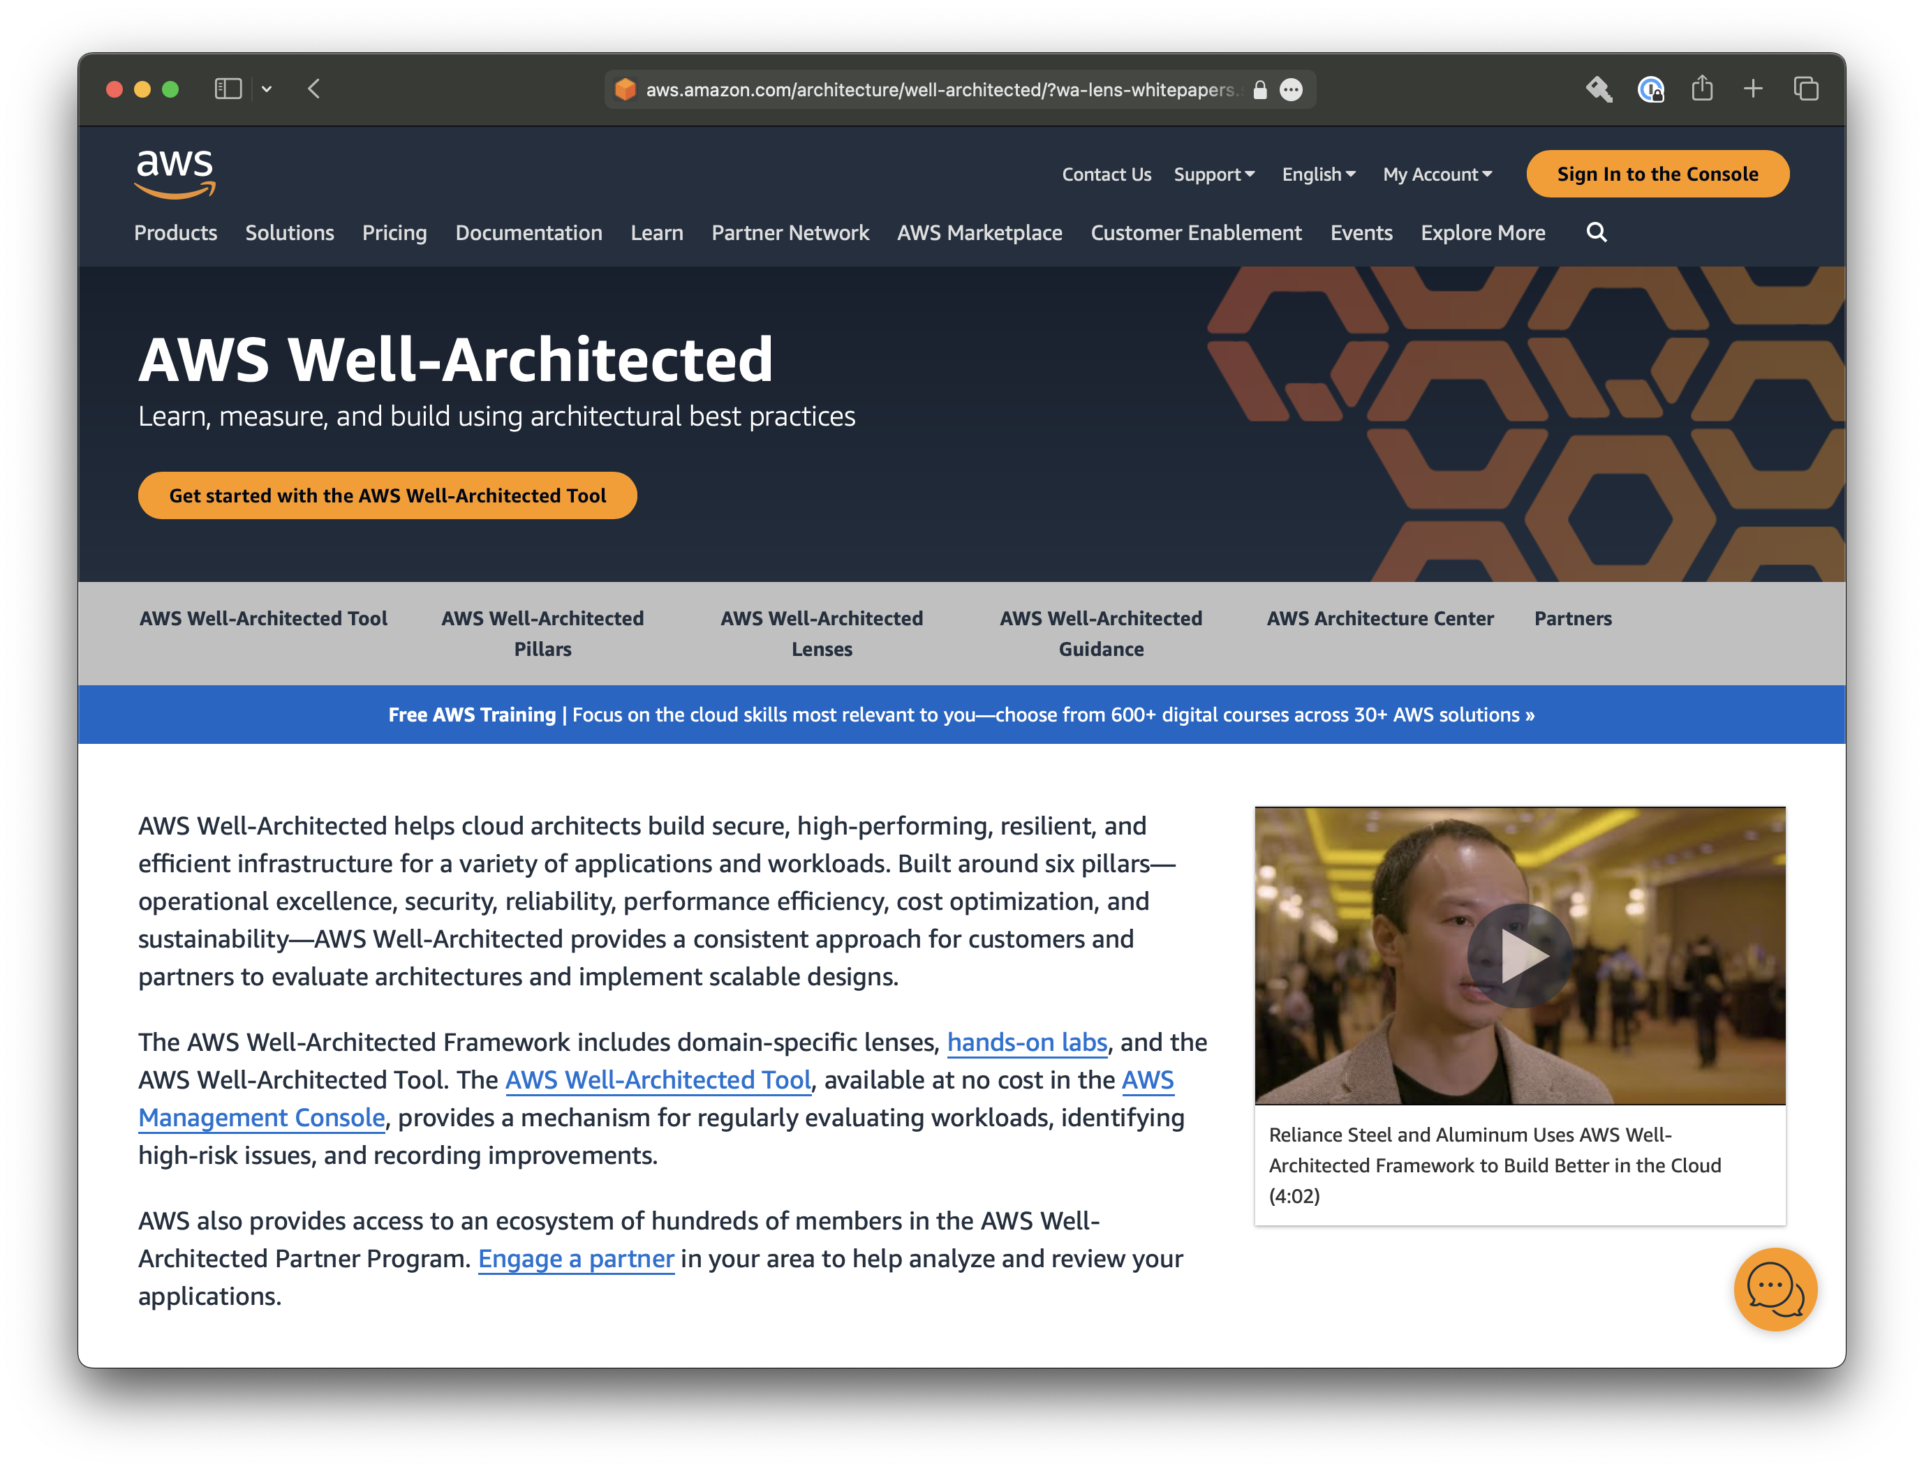

Slide 19
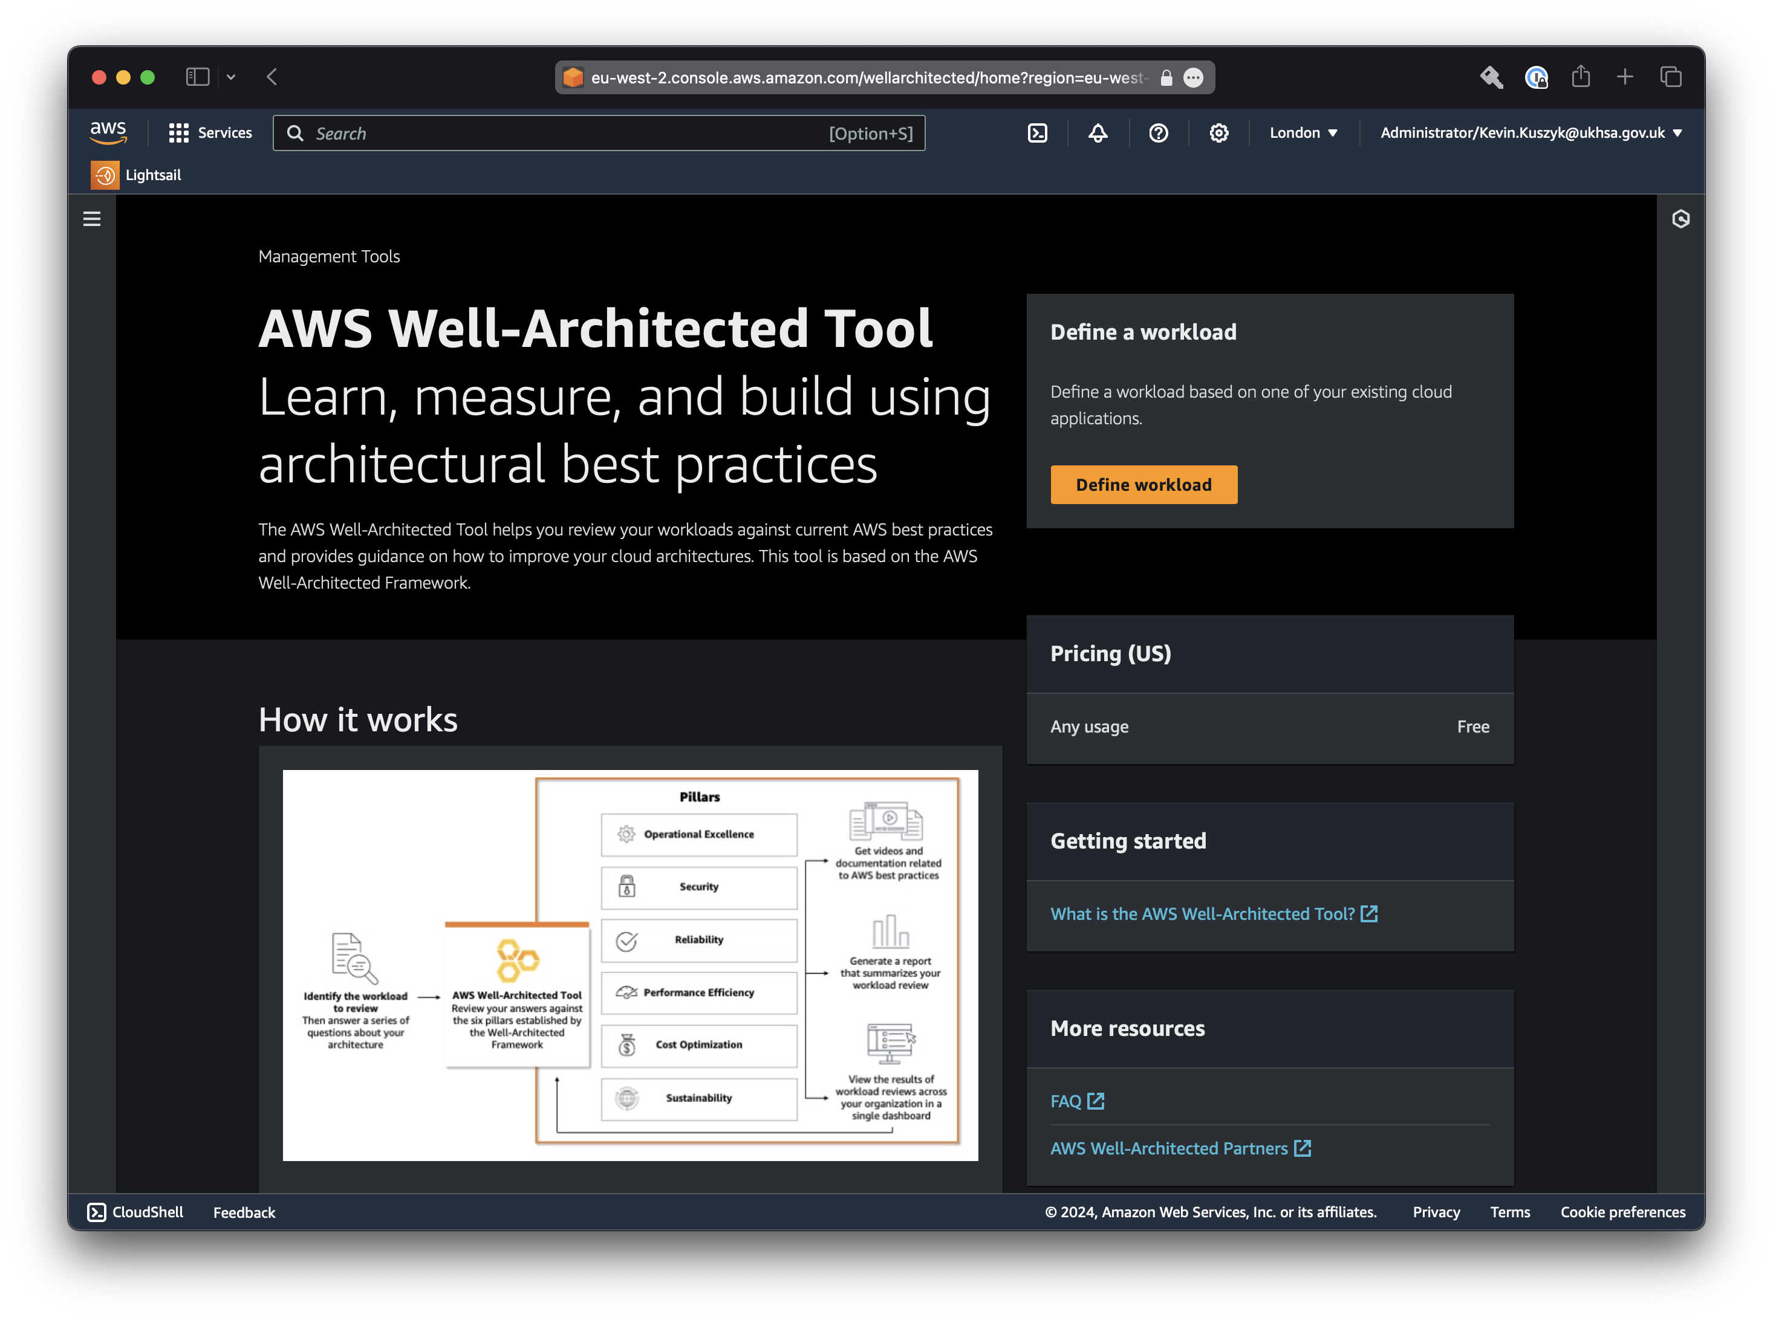
Notes:
The quickest way to get started with WA is to complete a Well-Architected Framework Review, using the tool in the console or with the APIs.
We recommend that Well-Architected Tool workload be created in the customer AWS account and stored securely with least privilege access in mind, with only the right people having access to the workload details.
Workloads can be shared with your SA and account team, or partner resource for collaboration on the review or remediation steps using workload sharing. Custom lenses can also be shared with our SA or partner resource for collaboration.
Trusted Advisor
On the trusted advisor checks tab, you can see that the AWS Well Architected best practice of perform data back up automatically has three trusted advisor checks that are relevant to determining if this best practice is being followed.
The AWS trusted advisor checks for this best practice include determining whether Amazon RDS backups are enabled, determining if Amazon S3 bucket versioning is enabled, in determining if Amazon EBS snapshots are enabled.
Next to each AWS trusted advisor check, customers can see the number of results for the resources that are being checked, and the number of recommendations for the resources that have been checked by trusted advisor.
If customers want more details, including the AWS resource names (a RN), they can click the download check details button to get a CSV file that contains all of the trusted advisor check details relevant to this past practice.
The integration with AWS trusted advisor requires that customers enter the AWS account IDs that contain the resources which are a part of the workload being reviewed using the AWS Well Architected tool.
Customers also need to configure the necessary permissions in the AWS accounts that contain these resources to allow the well architected tool to collect the AWS trusted advisor checks from the accounts that are a part of the workload being reviewed.
Check out the AWS Well Architected tool documentation page for more details.

Slide 20
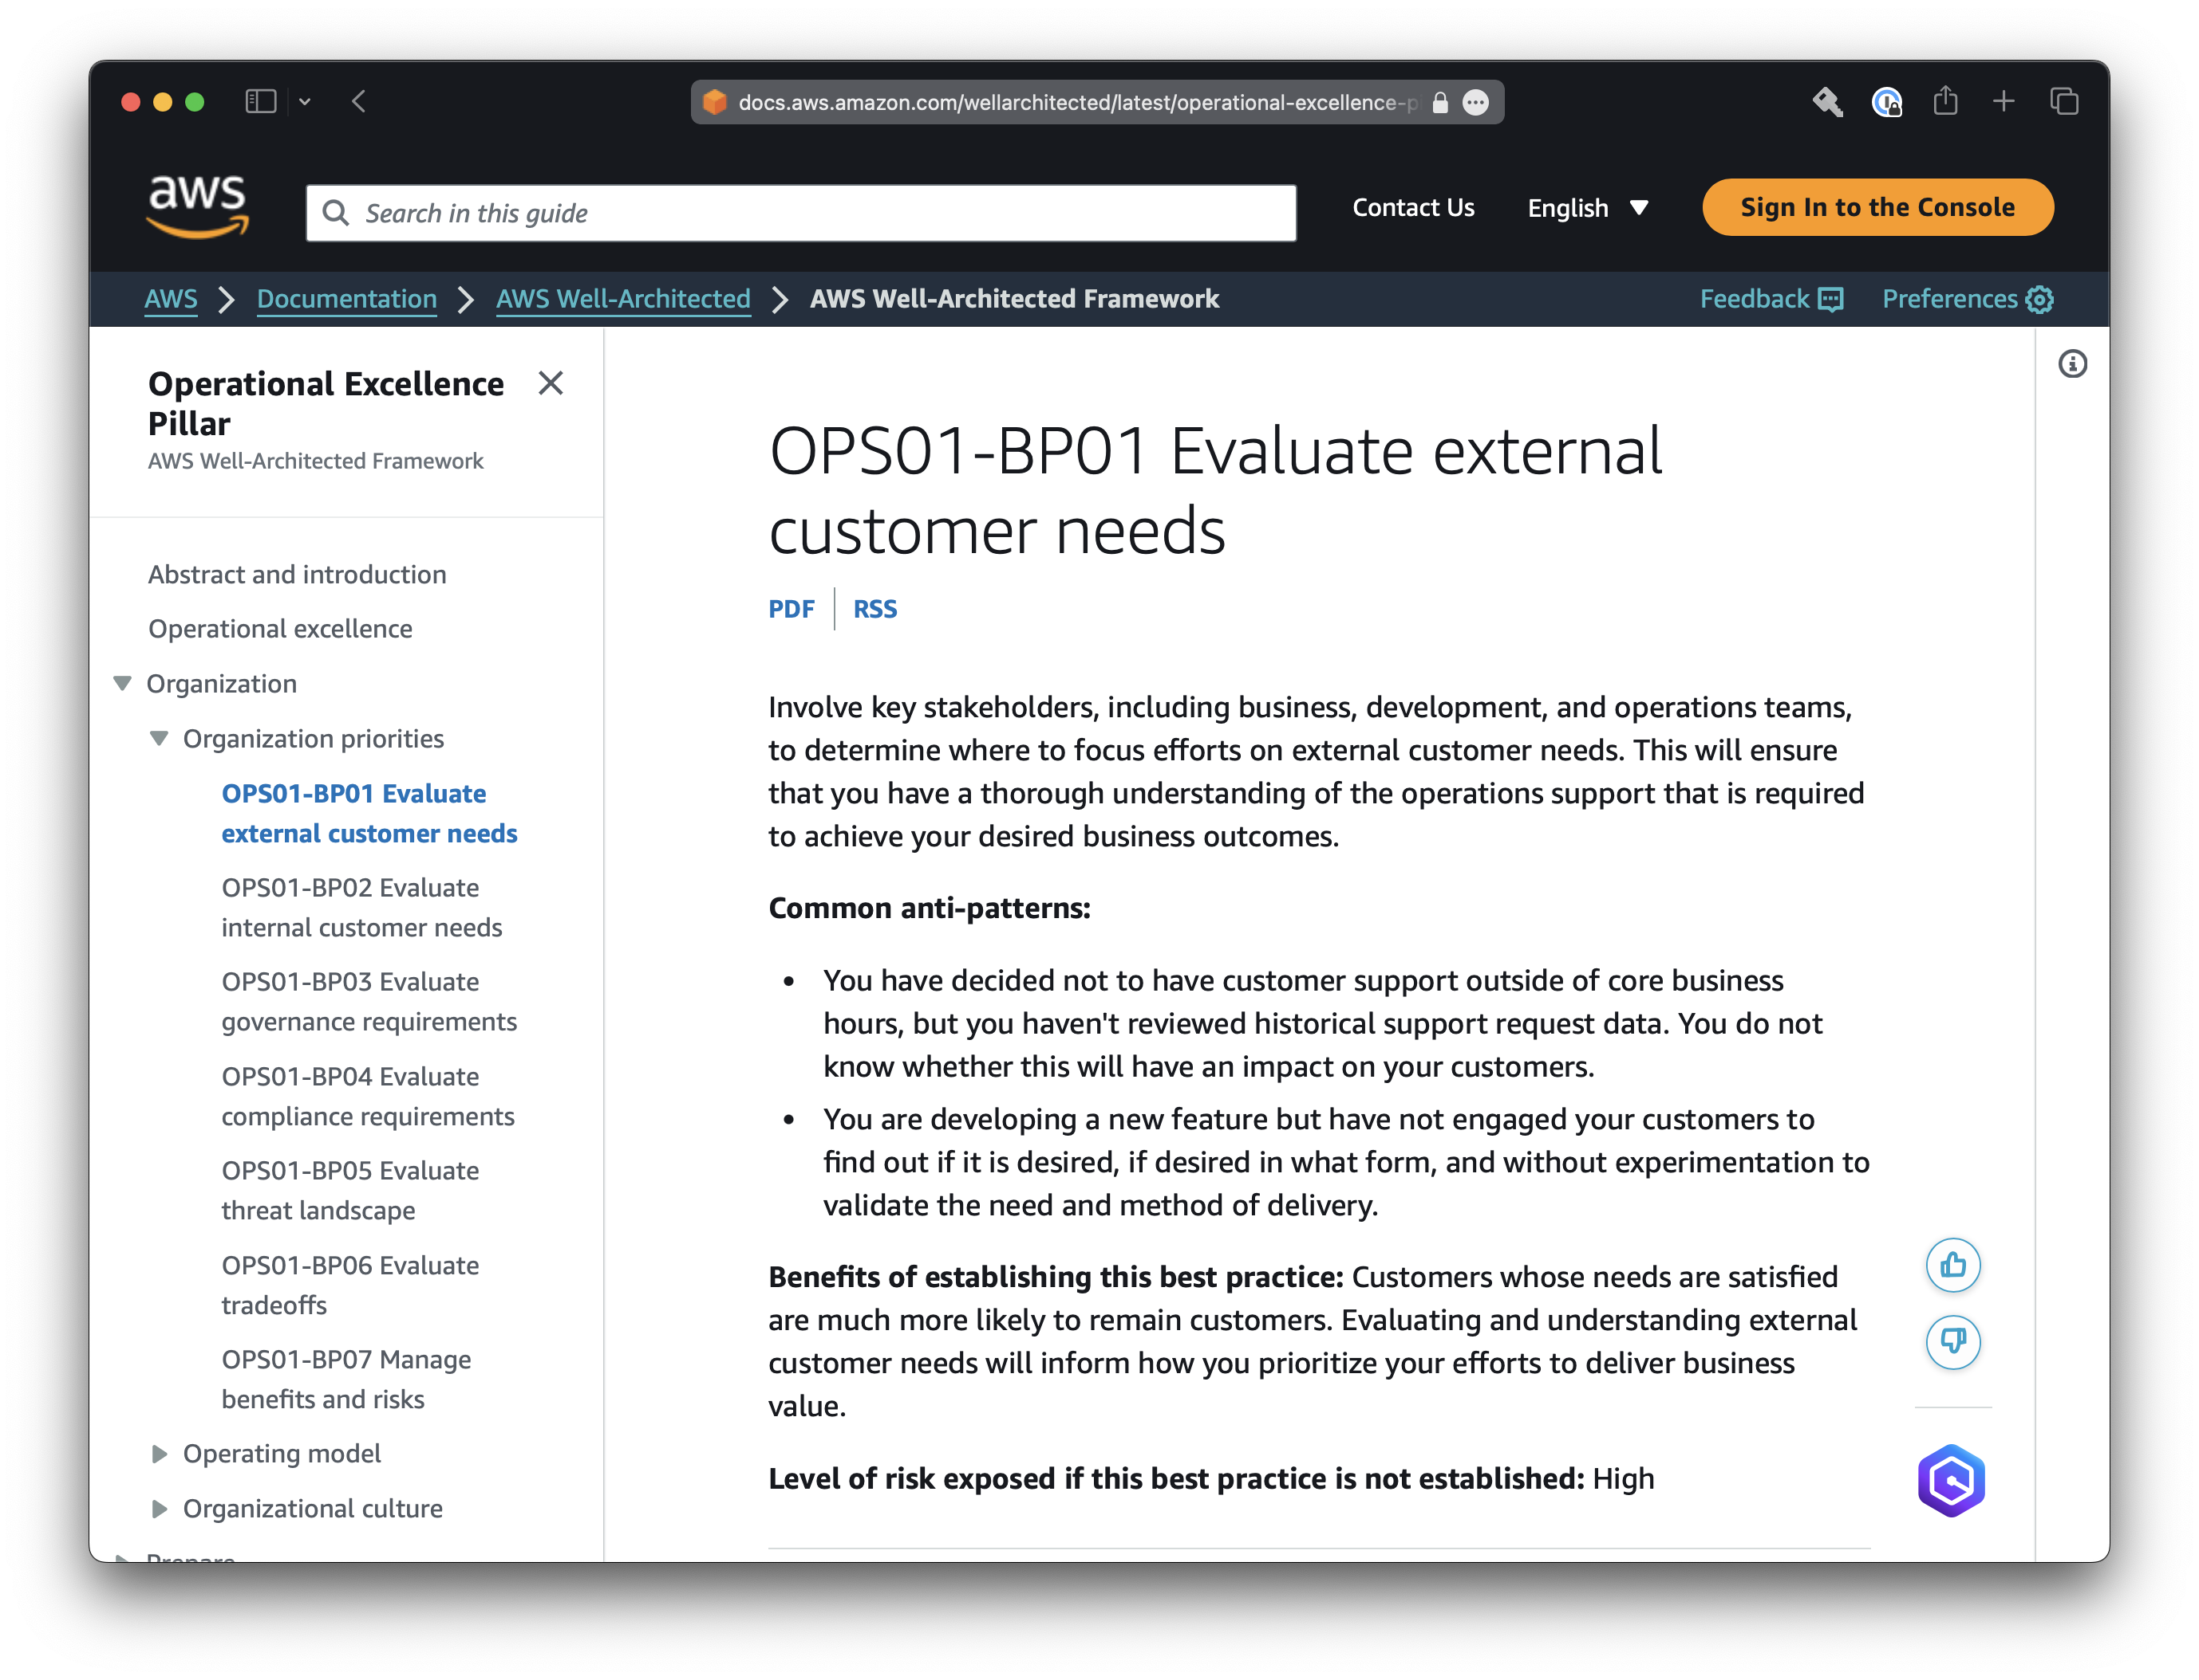

Slide 21

Where Next?
Notes:
So, where do you go from here? How do you get started with Well-Architected to improve your workloads or design with Well-Architected in mind?
ACTIONS
Identify customer sponsor for Well-Architected
Identify significant workload(s)
Discuss timelines & resources needed + complete Well-Architected training
Understand business context for review
Schedule review activities
Identify high risk items
Remediate
Repeat

Slide 22
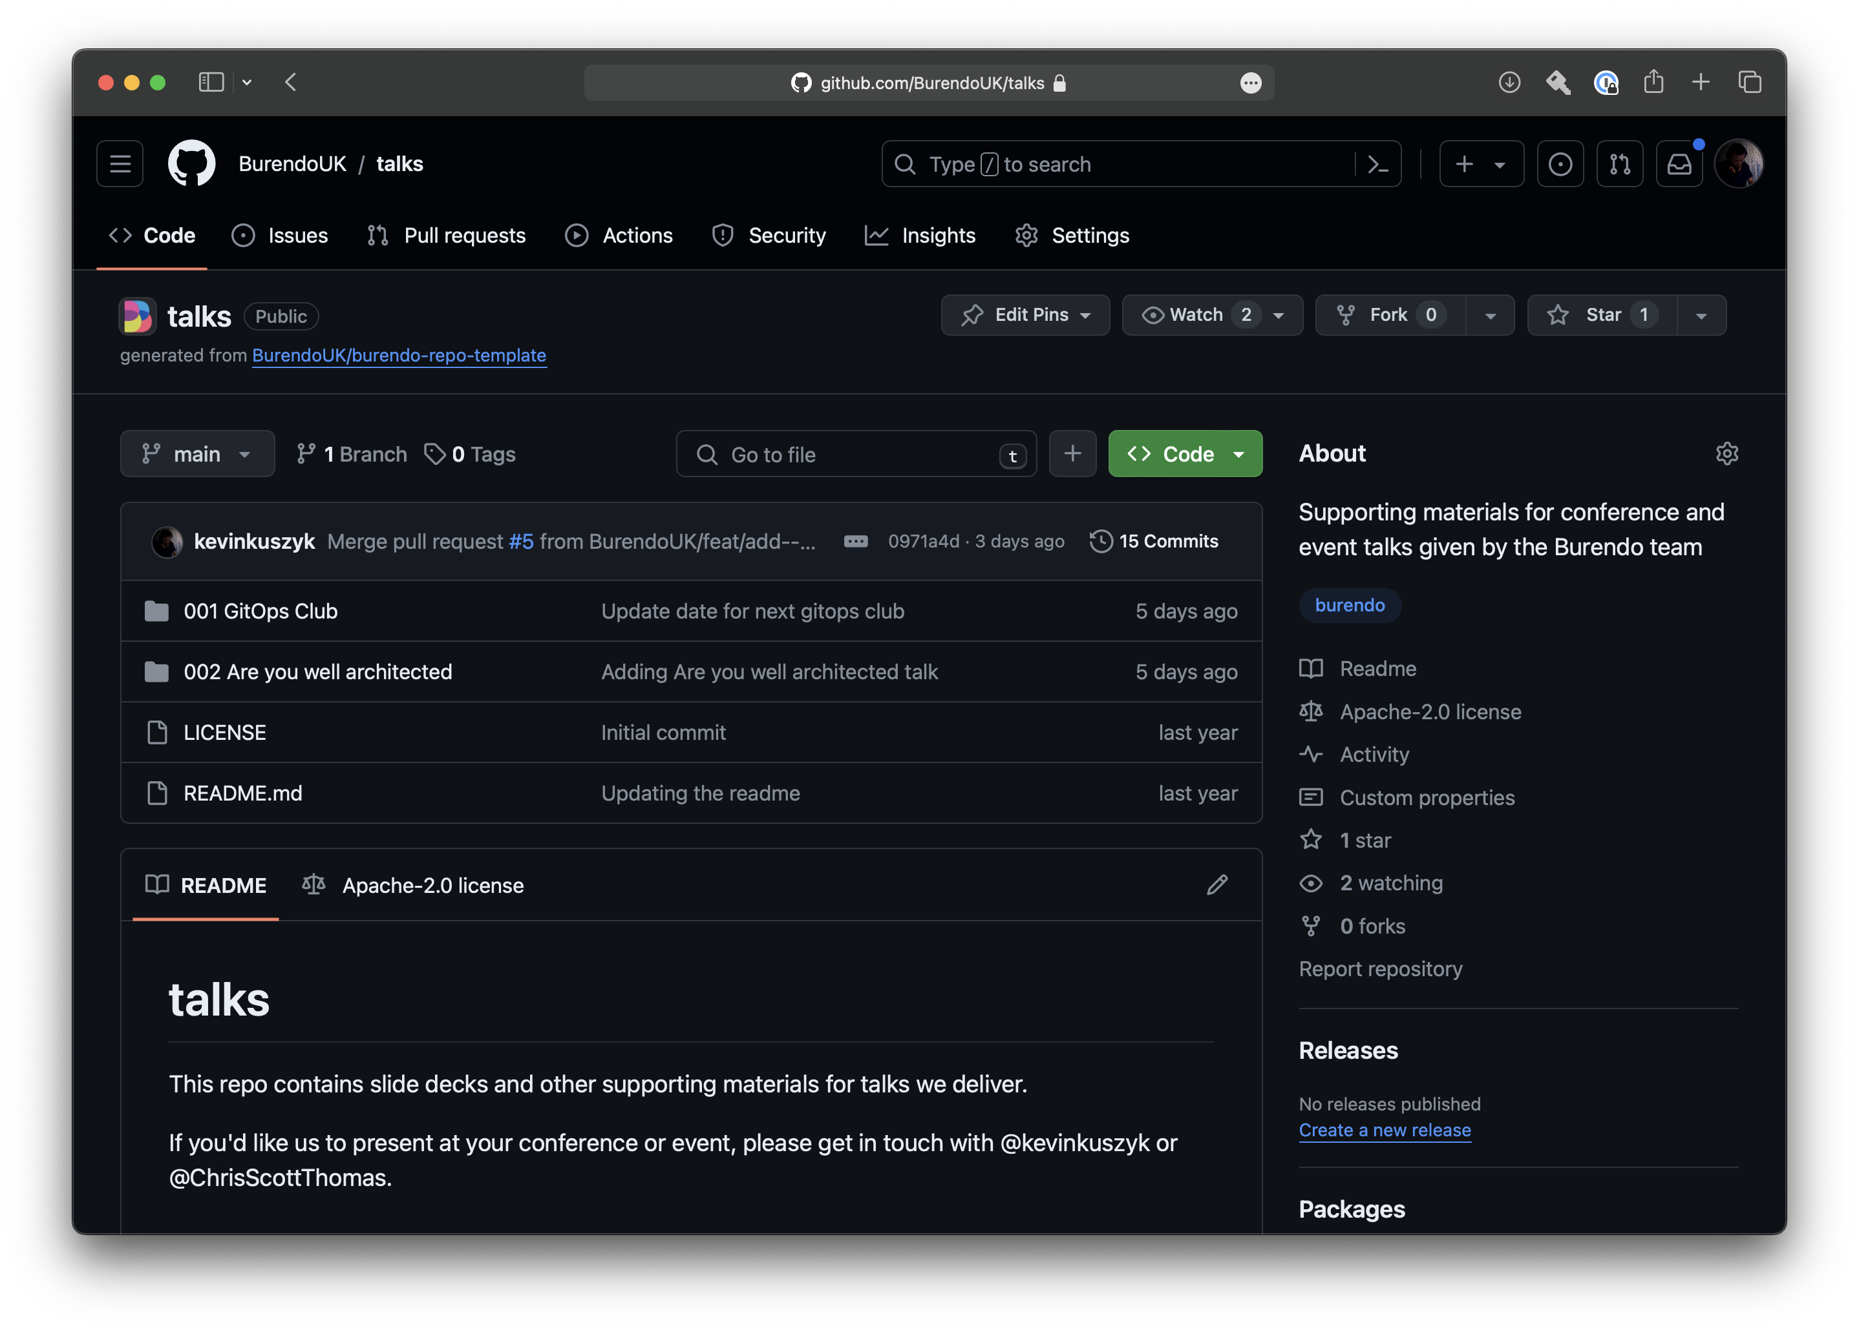

Slide 23
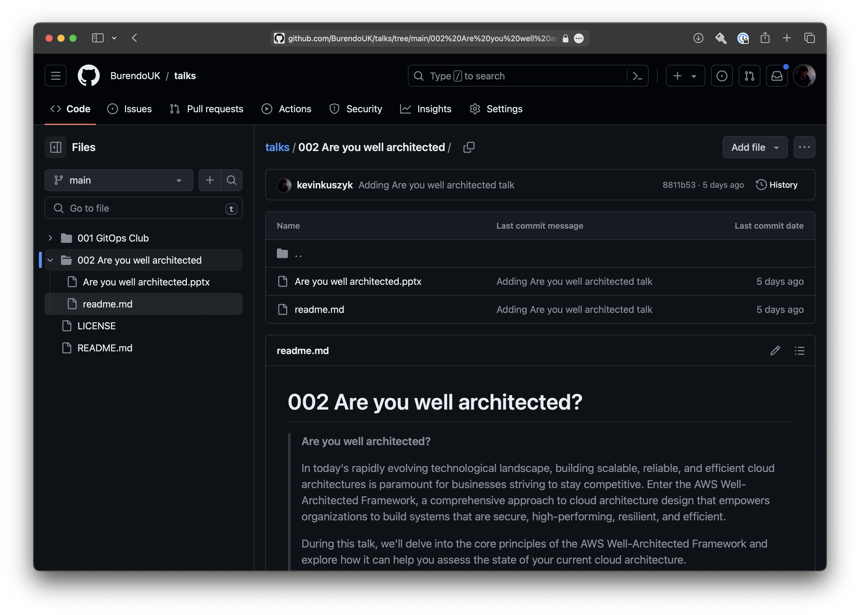

Slide 24
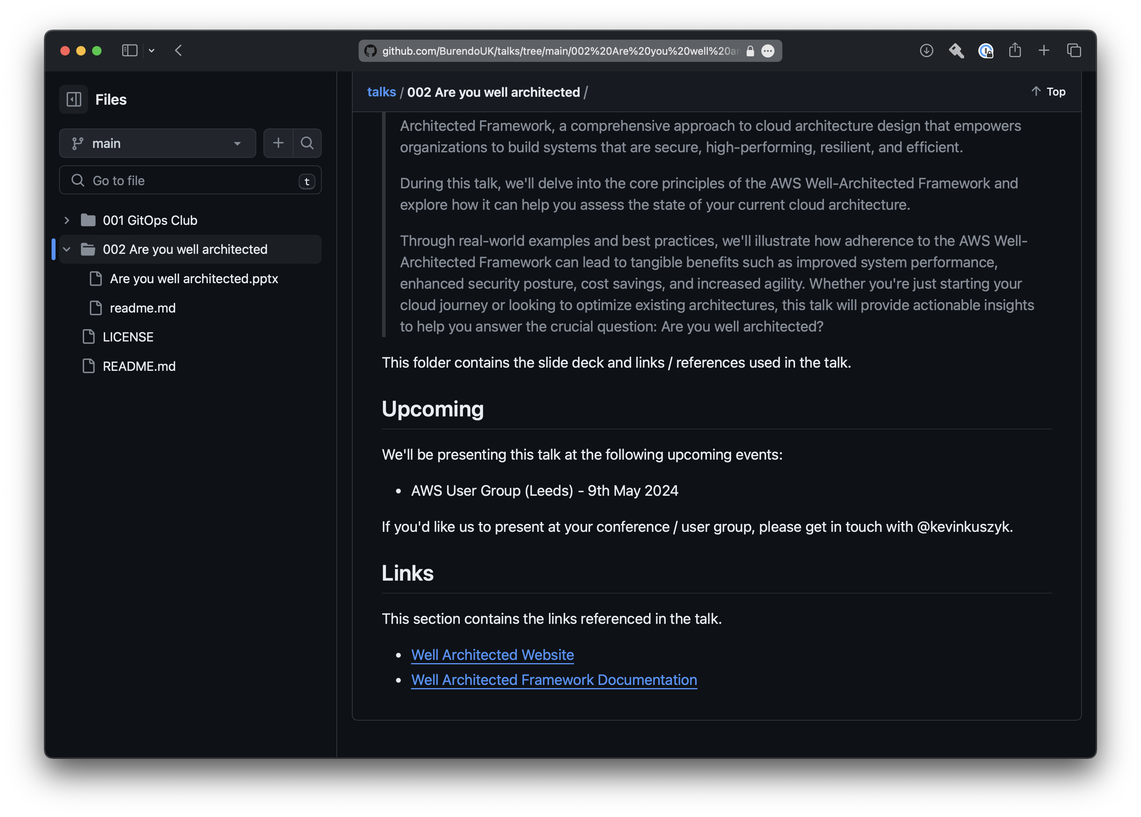

Slide 25

BurendoUK/talks
@kevinkuszyk
kevin.kuszyk@burendo.com

Slide 26
Thank you

